Slide 1
Building Families
Through Adoption
Welcome Back!

Slide 2
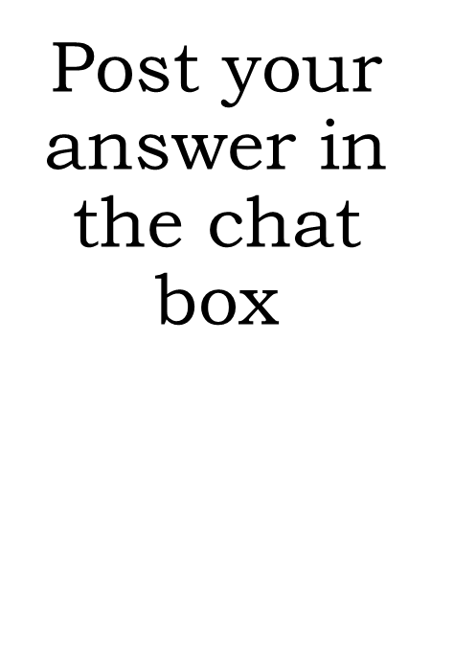
When you hear the words “survival behaviors,” what do you think that means?
Notes:
Chat Slide: Ask to put responses into Chat Box
DISCUSSION: When children do not have an adult to regularly meet their needs, they find ways to get their needs met which might include stealing, lying, looking for someone else to care for them, making up their own rules, hiding for protection, hiding food, etc.
Refer to HANDOUT #5-2: Reframing Problem Behaviors as Survival Behaviors Pay attention to idea of imported pathology into your family.
MAIN POINT: Instead of developing a voice and a way to get their needs met appropriately, youth lose this voice. They have had to rely on aggression, violence, lying and manipulation to get their needs met. These behaviors are brought into the adoptive home and while we want them to give up their survival strategies, they won’t until they have another way to get their needs met. They need to learn to trust us, and they won’t trust us until they know they are safe.

Slide 3
Trauma Informed, Adoption Competent Parenting
Session 5:
An Introduction to Trust Based Relational Intervention (TBRI)
Notes:
INTRO TO SESSION: This last session pulls together all the things we’ve been talking about and focuses on the healing power of an adoptive family. If we understand that your child has experienced loss and grief and trauma, and that this has impacted their developmental journey, how can you as an adoptive parent respond and parent this child in a way that will help them grow to be all he or she can be?
Our previous slide introduced the term survival behaviors, and this is a key concept to understand as we move into this final session. When it comes to parenting kids who come from hard places, they are going to exhibit behaviors that have helped them survive the difficult things they have lived through and when we can understand and recognize this, it is easier to view their behavior with compassion instead of something that needs consequences. These parenting strategies are going to prepare and assist parents to focus on building the trust and feelings of safety these children need to develop attachment to their adoptive family and let go of their survival behaviors.

Slide 4
Session Objectives
Learn
Learn how trauma impacts children and their development and why traditional discipline may not work.
Understand
Understand how a parent’s response can either calm or escalate a situation.
Acquire
Acquire a knowledge of how to apply the three principles of Trust-Based Parenting.
Practice
Practice concreate strategies to help manage difficult behaviors.
Notes:
In this session, we will…
Learn how trauma impacts children and their brain development and why traditional discipline may not work.
Learn how a parent’s response can either calm or escalate a situation.
Begin to learn how to apply the three principles of trust-based parenting.
Get an opportunity to apply and practice these strategies to help manage difficult behaviors.

Slide 5
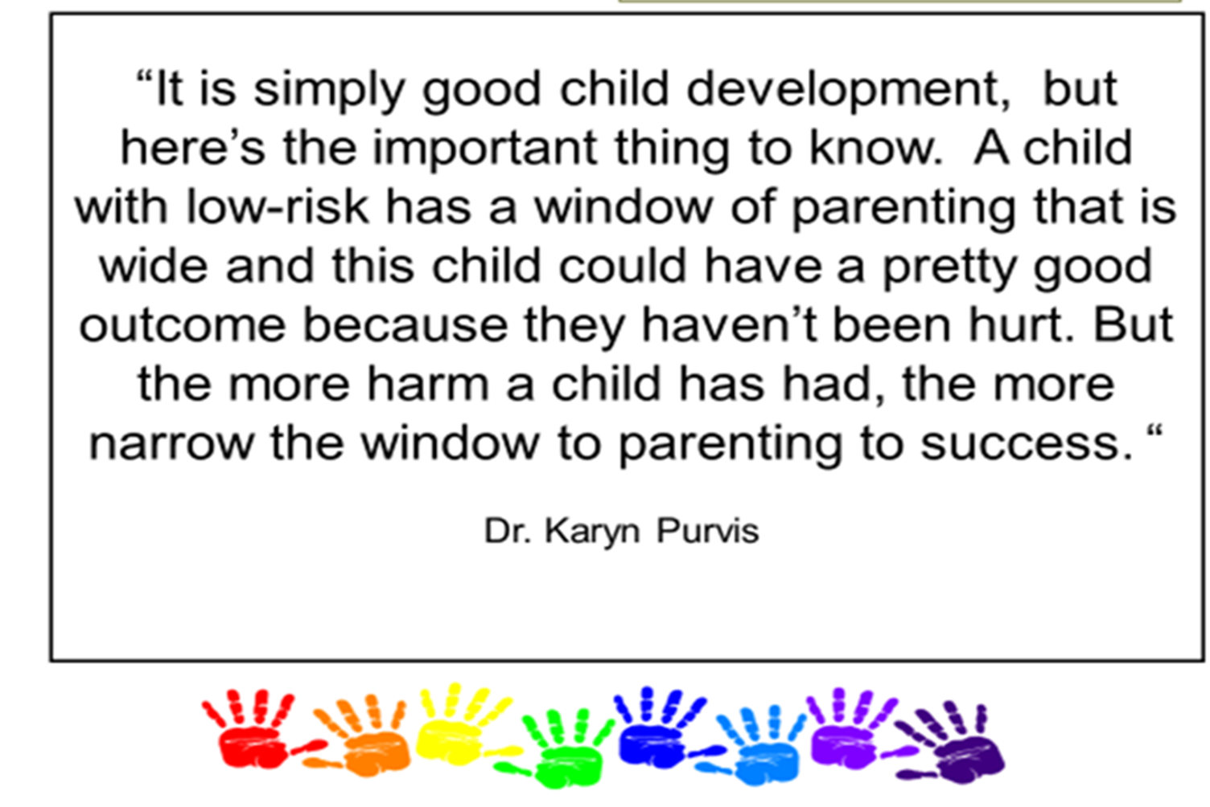
Notes:
READ QUOTE
MAIN POINTS:
In this course, we have discussed the impact of early trauma on children and how the journey through childhood and adoption can impact a child throughout his development. This session focuses on the healing strategies that can help adoptive families best parent and provide a healing environment to their children.
TBRI is an attachment based; trauma informed intervention designed to meet the complex needs of vulnerable children. Dr. Karyn Purvis, one of the creators of TBRI or Trust Based Relational Intervention, says bringing deep healing to children from hard places is simple. It is just not easy. Traditional parenting practices may work for children from low-risk backgrounds, but more focused, trauma informed strategies will be needed for children from hard places. Overall, TBRI is a strategy that focuses on connection.

Slide 6
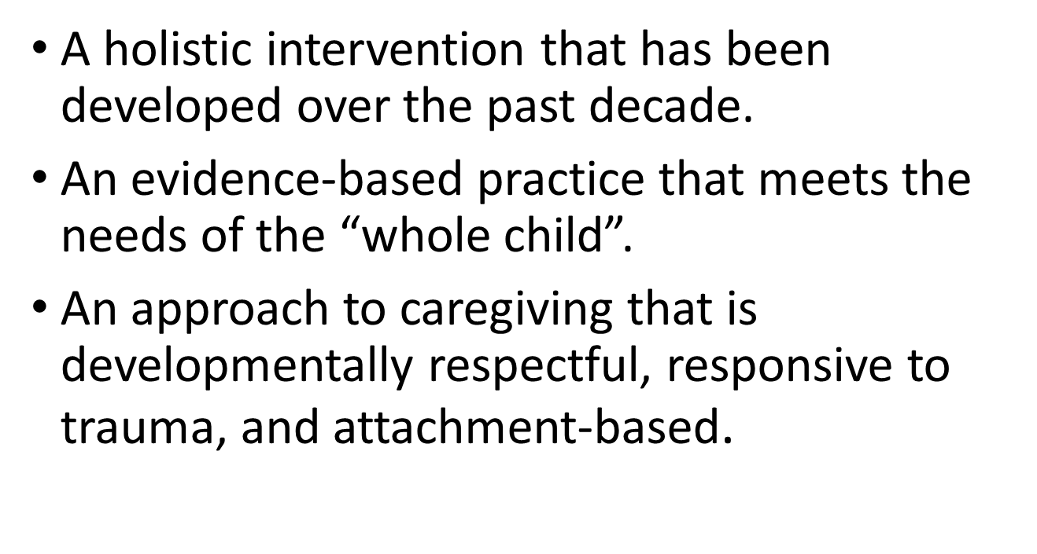

Slide 8
Three Principles of TBRI
Connecting
Empowering
Ecological: (Environment) Physiological (Body)
Correcting
Proactive Responsive
Notes:
Trust Based Relational Intervention is based on three principles.
Connecting: Communicating safety and building nurturing relationships.
Empowering: Meeting environmental and physical needs.
Correcting: Proactive and Responsive Strategies to Changing or Influencing Behavior

Slide 9
TBRI An Overview
Putting the Pieces Together
Notes:
Start at 20:58-25
INTRODUCTION TO VIDEO:
We will view 4 minutes of this video including Introduction to TBRI, and the Impact of Trauma on the Brain to help us get some context for what we will be covering today. This is part of a longer DVD series that is available in your local ACRF office.
PLAY VIDEO: Use the Disc or find you tube clip
TBRI An Overview: Putting the Pieces Together
https://www.youtube.com/watch?v=T43zJDgTNPA
MAIN POINTS:
As we move forward, we will be exploring these principles of TBRI as a way to approach connecting with, correcting and empowering the children in your home.
It is important to remember three principles as we move forward: we must first understand that these children have (1) significant changes in their brain development, brain chemistry, body, even changes in their biology, (2) leading to a different belief system. Believing they are unloved, don’t matter, they are “bad.” And it's all brought about by abuse or neglect early in their life. The third thing is that (3) every family who fosters, adopts or cares for vulnerable children is the greatest hope for every child.

Slide 10
TBRI – Make the Shift
Warden to Coach
Punishment to Correction
Time out to Time in
From fear to relationship
From reactive to responsive.
Notes:
. Going to feel strange to you. It is going to feel strange for your child. Don’t quit!
You are here to make a difference but sometimes we have to try something new in order to make that difference.
ACTIVITY: Ask participants to stand and fold their arms.
I want you to note which arm is on top. This is what comes most naturally and feels the most natural.
Now, put the other arm on top. How does that feel?
Now, put your arms down to your sides and then place them back in this new position.
Notice that you probably have to think before doing it and may not get it right at first.
You have body memory for what comes most easily. And this is like our children and their survival behaviors. This is what comes natural to them. That is what happens when we try something new. We have to think about it, it doesn’t feel comfortable, and we want to go back to the old way.
Trauma Based Relational Intervention or TBRI may be different than what you are used to or even what you’ve used before. We are shifting the paradigm, shifting what we do based on what we know about how trauma impacts the brain and the body, and the belief system in children. We are shifting from
Traditional parenting practices to trauma informed practices that consider how a child has been impacted by trauma in his life
We are moving from punishing of undesirable behavior as the main form of discipline to correcting behavior in the spirit of helping children learn the right behavior.
We are shifting from a Warden Mentality and catch children being bad to a Coach Mentality of encouraging and practicing the desired behavior with children.
We are shifting from Time out to punish a child to time in in order to build a connection to a child
We are shifting from seeds of fear sown between a child and his parent to strategies that build and strengthen a relationship
We are shifting from reacting to misdeeds to being responsive to the needs of a child as being expressed through the behavior and regulating ourselves in the interactions.

Slide 11
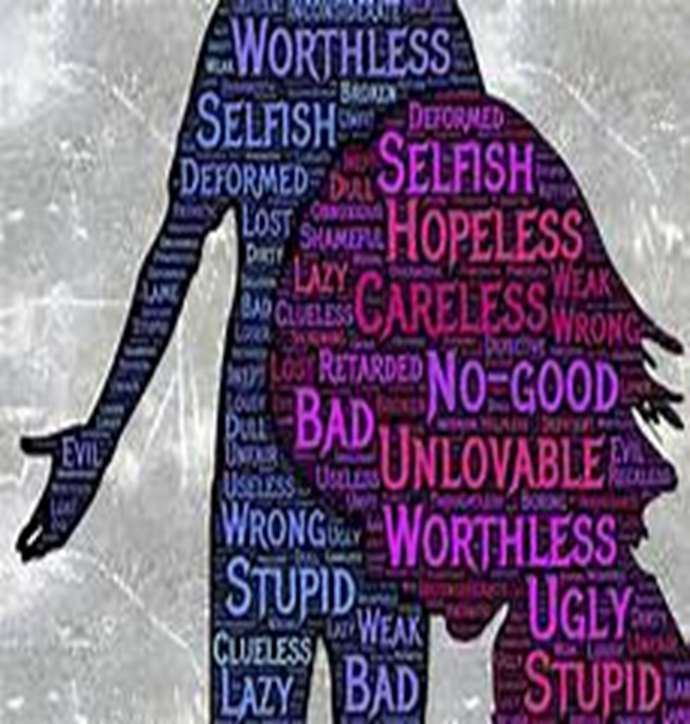
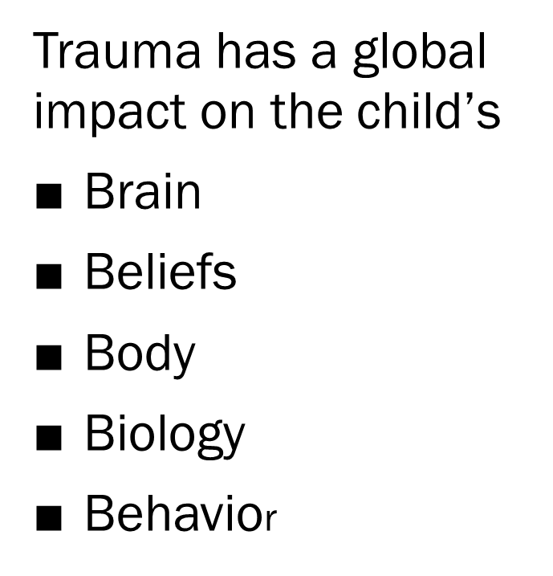

Slide 12
Understanding Risks
Difficult pregnancy
Difficult birth
Early hospitalization
Abuse
Neglect
Trauma

Slide 13
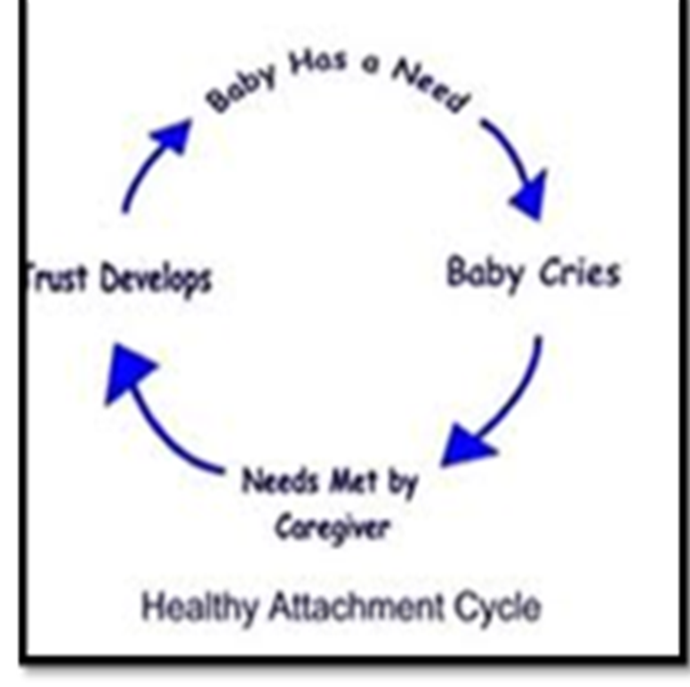
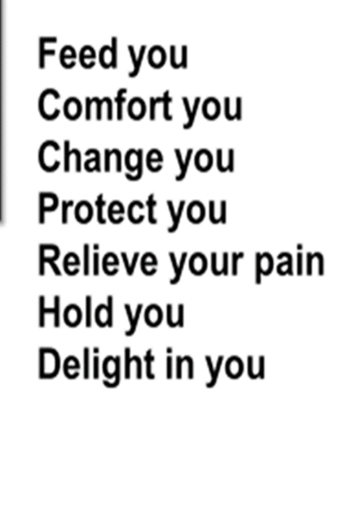

Slide 14
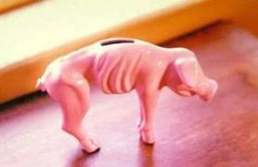
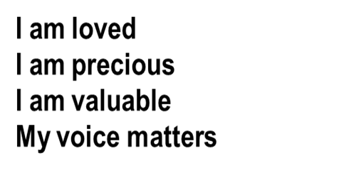
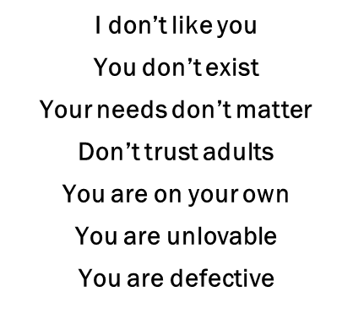
Changes in Belief Systems and Trust
Notes:
Remember these slides from our first session? The first stage of development in infancy focuses on trust and safety. This is communicated between parent and child repeatedly in thousands of interactions, either filling up a child’s trust bank with messages of “I am Loved, I am precious, my voice matters” or filling it up with messages of the opposite, "I don’t matter, I can’t trust, I am unlovable.”
As we have talked about in the previous sessions, if a child or youth grows through this stage without getting a solid grounding of trust, this is carried through the next stages of development. If children can’t trust the adults around them to help them survive or to give voice to what they need, they will do what they need to in order to survive, and this pattern of survival behaviors continues throughout development and their stages.

Slide 15
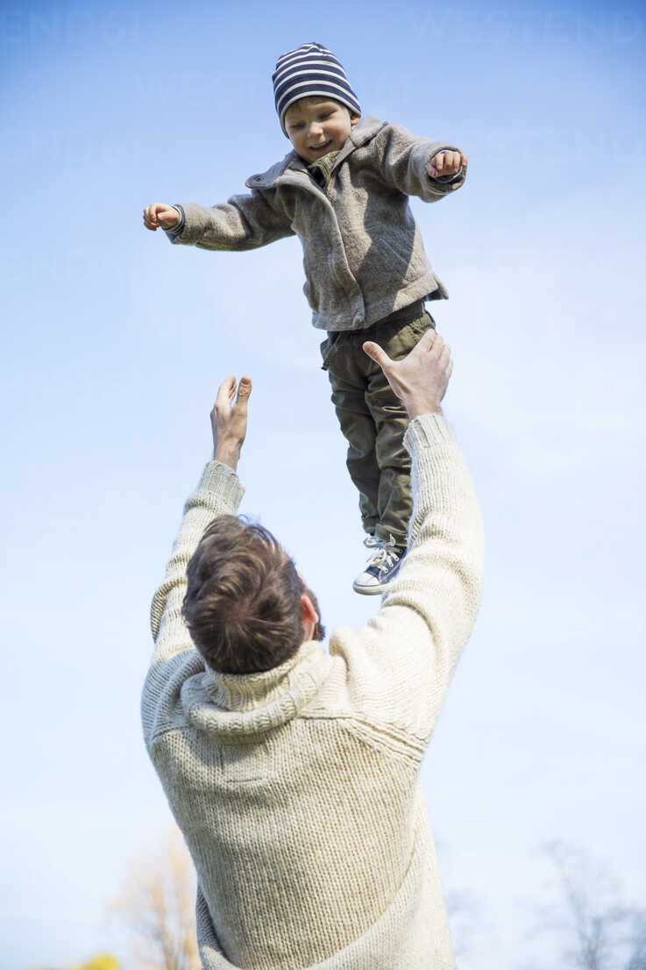
SECURE ATTACHMENT is the foundation for:
Self Regulation
Mental Health
Self Efficacy (voice)
Cause and Effecting Thinking
Self Esteem/Identity
Remorse
Compassion
Notes:
If the care the infant receives is consistent, predictable and reliable, they will develop a sense of trust which will carry with them to other relationships, and they will be able to feel secure even when threatened.
Attachment is the foundation to many skills and lessons that a child needs to progress successfully. With the stages of development, each stages builds upon each other. If one stage is not successfully completed, they will have struggles and challenges in the next stage. In fact, your general attachment style (such as secure or avoidant) is set around age 1 and stays consistent throughout the lifespan.
A secure attachment sets the template for
Self regulation – their ability to monitor and manage their emotions, thoughts, and behaviors in ways that are acceptable and produce positive results such as well-being, loving relationships, and learning.
Mental Health – their emotional regulation on how they think, feel, and act.
Self efficacy- is finding their “voice,” its that child’s belief in his or her ability to succeed in a particular situation.
Cause and Effect thinking- allows the child to reason about the things happening around them.
Self-esteem/identity- is the confidence in your own worth or abilities, having self respect. Identity- the qualities, beliefs, personality, looks and or expressions that make them. This includes self-image and individuality.
Remorse- having that guilt or regret of doing something wrong. Compassion- being able to be sympathetic or concerned for the sufferings and struggles of others.
Future relationships – Having healthy and secure attachments or relationships at an early stage in life will allow them to continue those healthy relationships when they grow up.

Slide 16
TBRI Principle:
Connecting Principles
Mindfulness: Engagement:
Self Care Healthy Touch
Self Regulation Eye Contact
Awareness Voice Tone
Co-Regulation Playful interaction
Behavior matching
Notes:
Building Trust allows you to let go of control
Trust the person to do as they say
Trust that the person cares about you and your needs
Trust the person will meet your need
Trust that the person will not hurt you
Trust the person has your best interest at heart
__________________________________________________________________________________________
The first of these principles is the Connecting Principles. The purpose of the Connecting Principle is to communicate safety and build nurturing relationship. Attachment happens through communicating safety, as we talked about, how you are present to the child. Attachment happens through attunement to a child’s needs and through a positive, mutually rewarding relationship between parent and child.
Think again about our child development principles. During that first year an infant gradually learns that their parent keeps them safe, anticipates and meets their needs, and communicates delight in the relationship between parent and child. This is often called a dance, and this mutual relationship of delight, joy, and connection forms a basis of trust if the parent is able to consistently provide for a child.

Slide 17
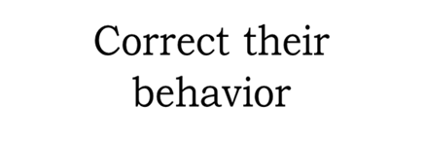
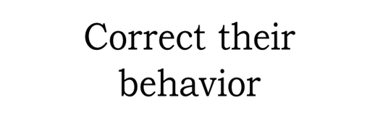
Connection
Where are you investing the bulk of your time?
Connecting: ___________
Empowering: __________
Correcting: ____________
Notes:
Connecting Principles: Create connections that disarm fear, gain trust, and enhance learning.
– Empowering Principles: Strengthen learning and regulation by meeting a child’s physical and environmental needs.
– Correcting Principles: Shape beliefs and behaviors effectively, so children feel safe, protected, and empowered.
soft touch or a mean and soft facial expression. We often practice this script by bringing a puppy or
kitten to the classroom and guiding the children in touching and holding them gently. If the child is being aggressive he can be prompted
with, “Was that gentle and kind? Try that again.” Praise him with, “That was good being gentle and kind!”
“Who is the Boss?” Children who have experienced unpredictable and chaotic experiences early in life often want to have control of others around them. A
way to deal with this issue is to calmly tell the child that the adult is in charge. When the child makes demands, ask them, “Who is the boss here? Are you the boss?” Once they acknowledge that they aren’t in charge, a response can be, “That’s right. Parents [teachers] are the boss. It’s not your job to tell others what to do.”
“Listen and mind ” The parent or teacher is the authority with the child. When a child is given an instruction, it can be helpful to remind them, especially if
they hesitate in following the direction, to “listen and obey.” Always follow with, “Good listening and obeying.” We implement “practice
drills” in the form of games that require immediate compliance, such as “Simon Says” so that the child can playfully practice the skill. By using the game “Simon Says”, we will ask the child to mimic our words, voice (tone, loudness) body, and facial expression “matching.”
“Accepting No” Although it is important to show the child that we care about her desires, it is necessary that she is also taught to handle occasional
disappointment without a behavioral meltdown. The child may ask to do something special, and the teacher responds in a kind but firm voice, “That is really good asking, but this time I’d like for you to practice ‘accepting no.’” Then, before the child can begin a meltdown,
the teacher quickly responds with the affirming praise: “Wow! That’s great ‘accepting no’!” In this manner, a child (almost) painlessly begins to defer getting her own way. By combining this technique with ample positive interactions, the child may begin to develop the
ability to comply, and to trust the adult.
Life Value Scripts: Handout.
From MLJ Adoptions
Children are not in need of families through international adoption because of happy circumstances. These children need a family because their biological family was unable or unwilling to do so. Poverty, abuse and neglect are likely to have affected your child’s early development. These children may not have had positive social skills modeled for them in their early years. Your child may have spent their early childhood in a group setting with little supervision or discipline. Social skills like respect, listening, and obedience necessary for navigating relationships with adults may be a foreign concept to your child. It is not fair to the child to expect he or she inherently understands the complexities of social interactions without such skills being modeled for them. For many children who have been adopted, the social skills necessary to successfully navigate their world can be taught through patience and practice with the help of parents.
Teaching our children “Life Value Terms” that are easy for them to understand, modeling the skill and having the child model the skill is key to helping children “from hard places” learn how to interact with the world. Dr. Karyn Purvis explains how important it is to use simplistic “Life Term Scripts” with just a few meaningful words to teach appropriate social skills. Dr. Purvis has coined many of these useful phrases that she teaches to parents. These phrases are short and to the point, so that children can understand the terms clearly. Being verbose or lecturing children, especially those with learning difficulties, often does not work in teaching and correcting social behaviors. Below are several phrases created by the TBRI® team that have proved successful:
“With Respect”
“Gentle and Kind”
“Are you asking or telling?”
“Listen and Obey”
Initially these phrases may be meaningless to a child, but it is up to parents to give those phrases meaning. To give the phases meaning the parent should model behavior and engage in puppet play or skit play to model the behavior. For instance, if I were to explain “gentle and kind” through puppet play, I may show one puppet character (Puppet A) shove the other character (Puppet B) out of the way in order to get a toy. Following this puppet interaction, the parent would explain that this is not “gentle and kind,” and this hurt Puppet B. Then, you would show the child what that interaction would look like if Puppet A were to act in a “gentle and kind” way. Perhaps Puppet A would say to Puppet B “excuse me, I would like to get to play with that toy.” Then you might explain to the child that this is “gentle and kind,” which is the acceptable social behavior.
For older child, you may conduct a short skit with them, where the child plays the role of the parent and the role of the child. For instance, the child may take the role of the child in the skit and show an example of the child being sassy in asking to stay up longer because she does not want to do to bed; this would be an example of “no respect.” The child could then practice asking respectfully and receive praise from the parent for doing so. The parent and child may also want to switch roles, so that the child can feel what it would feel like to be spoken to without respect as the “parent.”
One important aspect of modeling behavior through puppet play or skit play is to remember to always act out the preferred behavior last and praise the child. This is important so that the child has motor memory of the positive behavior last and so that they experience praise at the end of the lesson. If the child experiences praise, they are more inclined to want to engage in the same type of lessons again. In addition, through the use of puppet and skit play, we are proactively teaching the child life skills, as opposed to only reacting to and correcting behaviors that are negative. This proactive approach helps to develop a trusting relationship and furthers the connection between parent and child. It shows the child that their parent is on their team and that the parent wants the child to be successful. This also allows the child to learn which behaviors are appropriate and which are not in a safe way and during a calm time. A child is much less receptive to this type of leaning in a higher stress time and especially if they are having a meltdown.
Photo Credit: Glyn Lowe Photoworks
Purvis, K.B. & Cross, D.R. (2013 September). TBRI® Professional Training Program presented by the TCU Institute of Child Development. Training conducted at Texas Christian University, Fort Worth, Texa

Slide 18
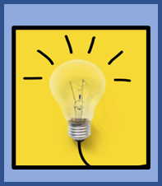
On your worksheet, answer the following;
Self Resiliency:
a. Name one thing that recharges and refills your physical and emotional bucket.
b. When will you do it this week?
2. Self Regulation: Pressing the pause between behavior and response.
a. What makes your crazy? (what ignites your anger?)
b. How will you stay calm when ignited?
3. Ideas:
Deep breathe
Calming self talk-mantra
Snack/water break
Tap/Tag Out
Step Away
What else?.....

Slide 19
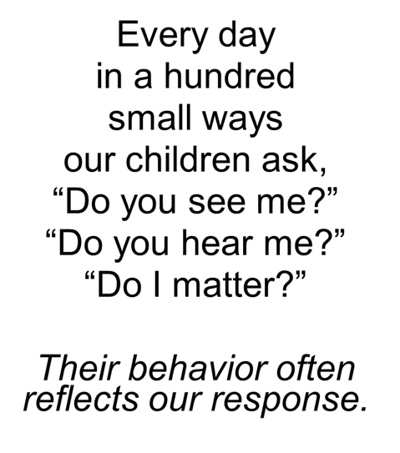
Connection: Engagement
Engagement Strategies communicate
“You are precious, you are safe, your voice matters”
Healthy Touch
Eye Contact
Voice Tone, cadence
Playful interaction
Attunement
Attentiveness
Note: This is multisensory

Slide 20
The Dance of Serve and Return
Examples
See you later alligator….
1…2… 3….
Eyes on me!
I love you for always,
I like you forever
Notes:
Wreck it Ralph.
The first lesson of life is trust vs. mistrust
The giving of yes’ – Over 100,000 times in the first two years of life
This is the foundation for self esteem, identity, voice, self regulation and mental health
This is the heart of TBRI and the template for the child’s belief about themselves.
Make reference to video of father and infant son on couch and they were having a conversation. (Possibly play if time)
SHOW VIDEO and ask folks to put into the chat box what they see the father doing that builds a relationship of trust and safety with his son.
DISCUSSION: The video illustrates communication through love and full attention. Have you ever had an unsuccessful conversation with someone looking at their phone? Their attention is diverted and somewhere else. You might even give up and pull out your own phone. Our kids are hypervigilant to tone shifts, expressions of exasperation, etc. They may be hypersensitive to feeling safe, recognized, and cared for and can easily be triggered into their “downstairs” or survival brain.
CHATBOX QUESTION: What are ways we can attune into children, take care of their needs, and provide safety to children in your homes who may be coming from hard places?
ANSWERS MIGHT INCLUDE: Use Language, Your Voice, Your Closeness; Communicating Preciousness through affection and words/pet names; use your eyes to communicate affection; use touch in a gentle loving way; Be present, stay regulated
The goal is to communicate “You are precious. You matter. You are safe.”
The attachment dance:
In tune and attentive.
Exaggerate joy
Comfort pain
Instill self worth and value

Slide 21
“It is an absolute human certainty that no one can know his own beauty or perceive a sense of his own worth until it has been reflected back to him in the mirror of another loving, caring human being.”
Be the reflection of your child’s self worth
Notes:
The first lesson of life is trust vs. mistrust
The giving of yes’ – Over 100,000 times in the first two years of life
This is the foundation for self esteem, identity, voice, self regulation and mental health
This is the heart of TBRI and the template for the child’s belief about themselves.

Slide 22
Questions/ Comments? TBRI Part One

Slide 23
Empowering Principles
The Empowering principles prepare the body and brain for success by meeting the physical needs and prepare an environment that meets the internal physical needs of the youth.
Ecological (Environment)
Physiological
^{Transition Warning}
^{Routines and Rituals}
^{Artifacts (loveys)}
^{Predictable Schedule}
Regulation Checks (Engine Plates)
Hydration and Nutrition
Sensory Needs
Calming Techniques
Sound Sleep
Physical Activity
FAST Kit
Notes:
Ecological is setting up the environment for success. Physiological is meeting the needs of the body.
The second principle is the Empowering Principle which means to empower the child by meeting their physical needs and structuring the environment around them so that their needs are met consistently. We are not only helping them regulate their physical needs, but we are helping them regulate their brains as well.
This principle is especially important for children who come from a difficult earlier background. These children often grew up in a fear-based place and they bring that fear with them to all of their relationships. They don’t have banks full of trust that they can fall back on. Empowering strategies help build an internal sense of trust and safety.
The Empowering Principle has to do with empowering the child's physical needs and setting up a sensory rich environment. We take care of the basics (Food- Activity- Thirst) Sensory input gives a child the chance to use their senses and lets them have a mental break. They can go outside to touch the grass, smell the breeze, stick their hands in the sand, or dip their feet in the creek, all of which help them feel familiar with their environment and enjoy their surroundings. To foster healthy bodies, we try to make sure a child drinks plenty of water and has a nutrient-rich diet. Both of these things are essential for their physical and emotional well-being. We help empower children and youth environmentally (the things around a child) and we help the youth learn to be empowered internally. We do this by introducing predictability through a daily routine and allowing for smooth, notifiable transitions of change in their environment (i.e. letting them know ahead of time what will happen next, notifying them when you leave the room, letting them know when you’ll return, etc.). By allowing children to feel secure in this way, we can help strengthen their grip on the ups and downs of life itself. The empowering principle is important when managing tantrums and meltdowns.

Slide 24
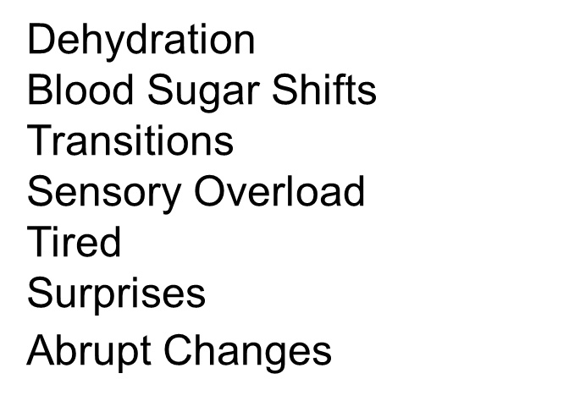
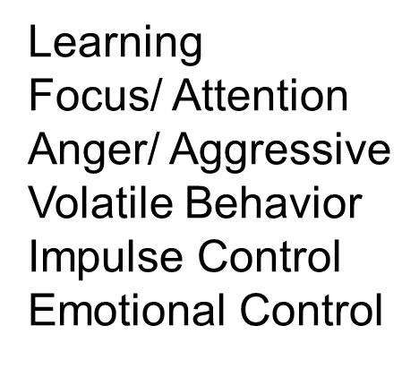
Feed Lower Level Systems to Encourage Higher Level Functioning
Notes:
Complete shutdown, meltdown, bad attitude, etc, fit…. Low frustration.
Legs of a table. One factor, wobbly, two or more, gonna crash hard.
When your child is heading for a meltdown, Stay CALM, Think FAST.
Safety in familiarity and routine. - Did not feel safe driving in Tampa;.

Slide 25
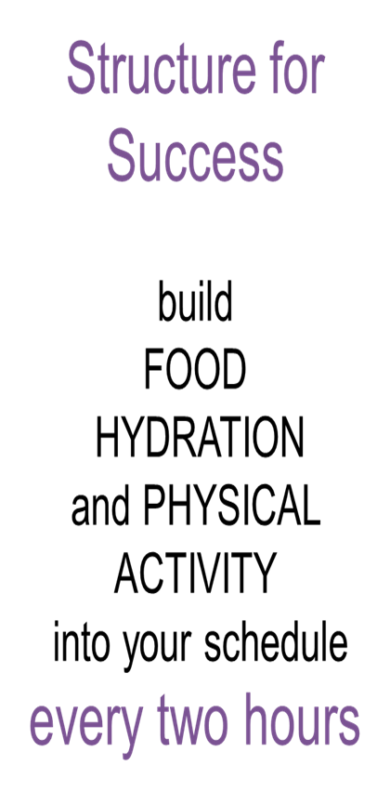
Notes:
When your child is heading for a meltdown, Stay CALM, Think FAST.

Slide 26
Headed for a meltdown? Stay C.A.L.M
C
CELEBRATE the need
LOOK for FEAR
MENTOR regulation
ATTEND to the need
A
L
M
Notes:
When your child is heading for a meltdown, Stay CALM

Slide 27
Think F.A.S.T
F
FOOD
Get a snack
A
ACTIVITY
Move, stretch, wiggle
S
SENSORY
Too hot/cold/scratchy/tight/
wet/sticky/mushy?
T
THE THREE T’s
Tired? Thirsty? Transition?
Notes:
When your child is heading for a meltdown, Stay CALM, Think FAST.
When a storm is approaching, think FAST. Trauma and stress impact the brain. So, to prevent dysregulation, it helps to regularly meet some basic physical needs. You can prevent a lot of problems by building these ideas regularly into your schedule. FAST stands for
Food-- small healthy snacks and regular meals keep blood sugar at desired levels. Think every two hours. Activity—movement helps the brain function better Sensory—meeting our sensory needs helps us regulate ourselves. Tired, thirsty, transition—Our bodies function best when we get regular sleep and drink adequate water to stay hydrated. Transitions or time of change tend to be triggers for children with control issues or regulation issues, so give warnings and transition time ahead.

Slide 28
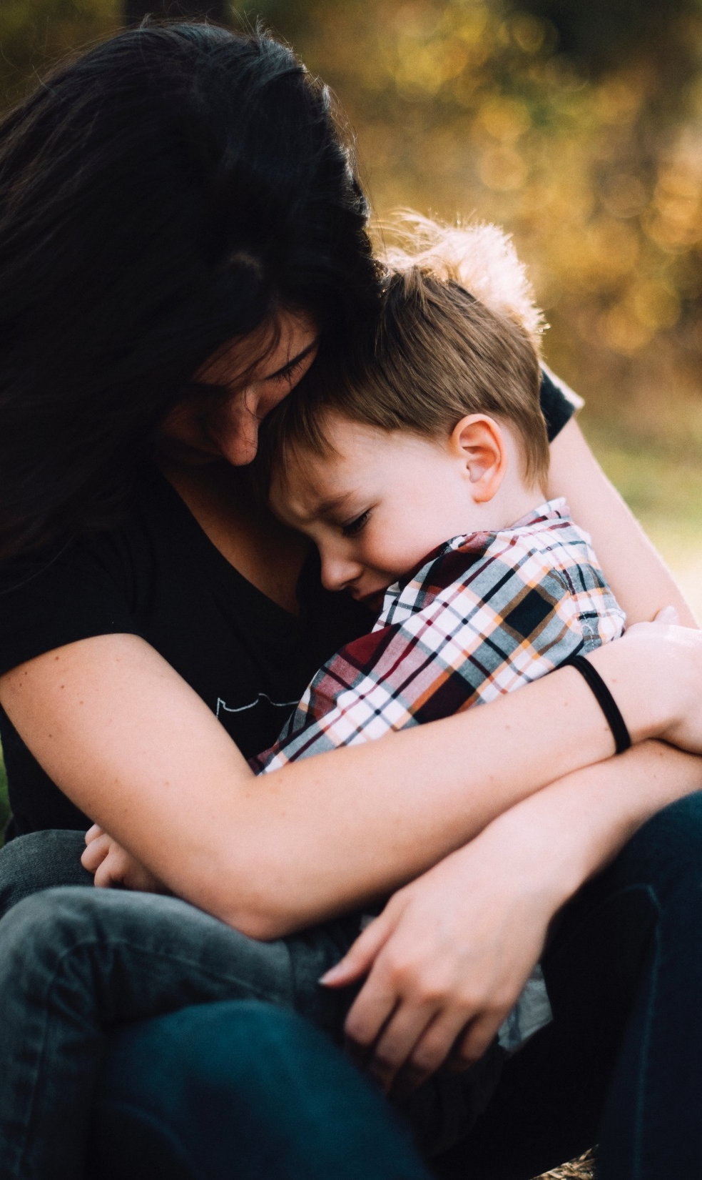
Teaching and
Practicing Regulation
Regulation is learned in relationship.
Infant:
External regulation
Toddler:
Co-regulation
Childhood: Self-regulation
Be the safe place
Notes:
Regulation is learned in relationship. Regulation starts with external regulation (infant) to Co regulation/ (toddler) to self regulation.
How many folk would agree that many of the kids we serve struggle with controlling and/or managing their emotions /feelings?
Do they flip their lid when frustrated, told no? Get tired, hungry, lonely or scared? This is a self regulation issue, stemming from what didn’t happen in their early years
You start by being the “safe base”. The comforter, while teaching them the skills to regulate. Then you practice until they have achieved mastery.

Slide 29
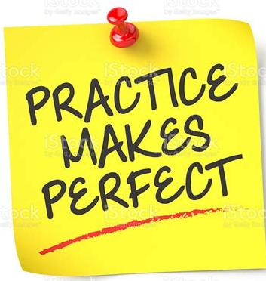
4 Tools To Teach Regulation
Engine Plates
Just Breathe- Glitter Jars
Teach Breathing: Soup Activity/
Blow out the Candle/Smell the Flower
Practice the skill if you want to master
the skill
Cosmic Kids or Kid’s Choice https://cosmickids.com

Slide 30
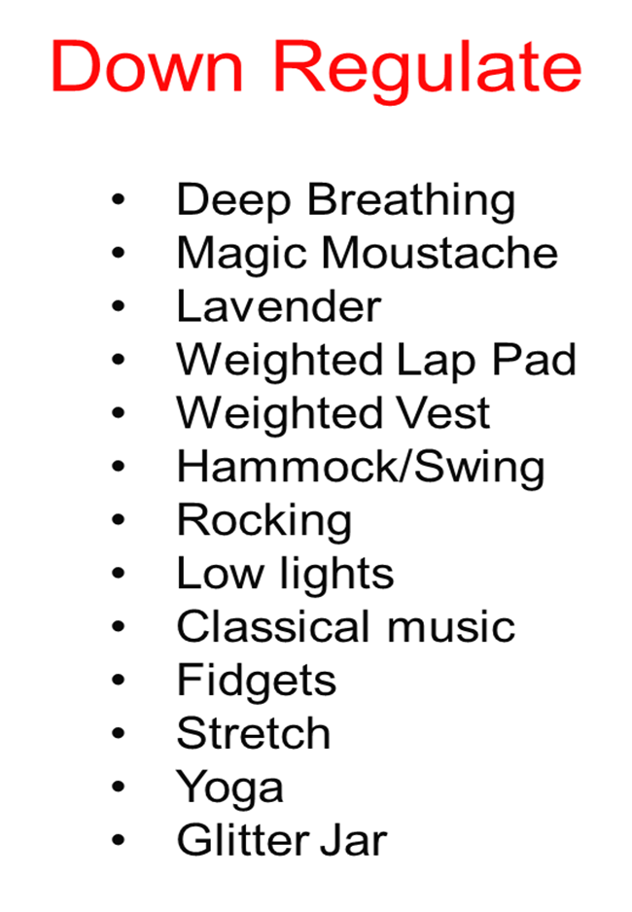
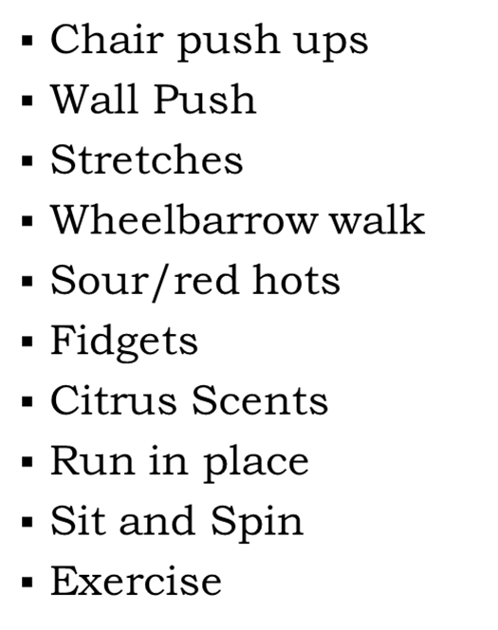
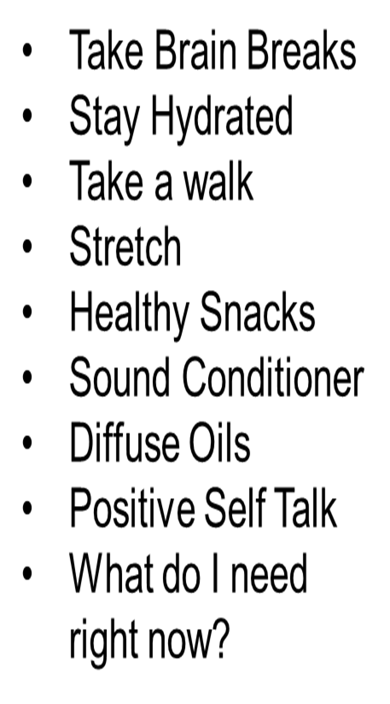

Slide 31
Tools to Teach Regulation
by Julie Bayer Salzman & Josh Salzman
Notes:
Back, take off the Velcro piece and breathe, ground yourself for the next session. Julia will do this and then introduce me.
Make a glitter jar and teach them how to recognize their emotions, then how to calm.

Slide 32
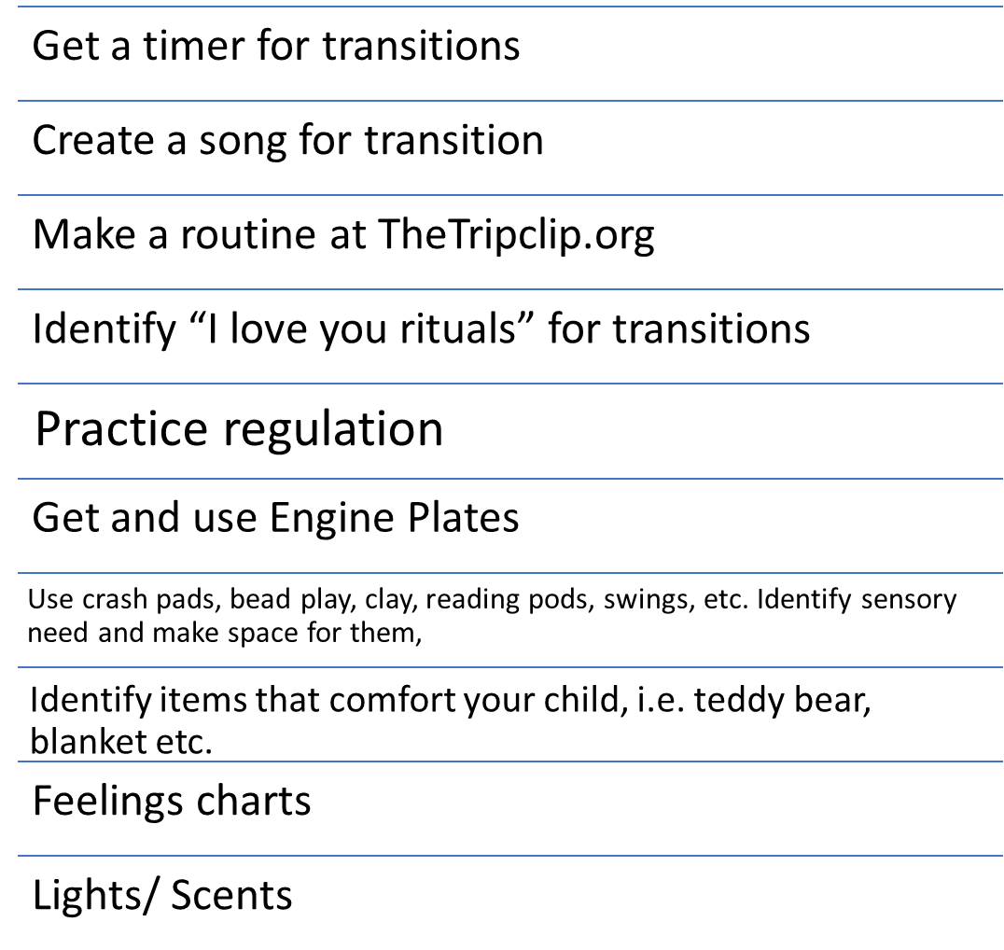
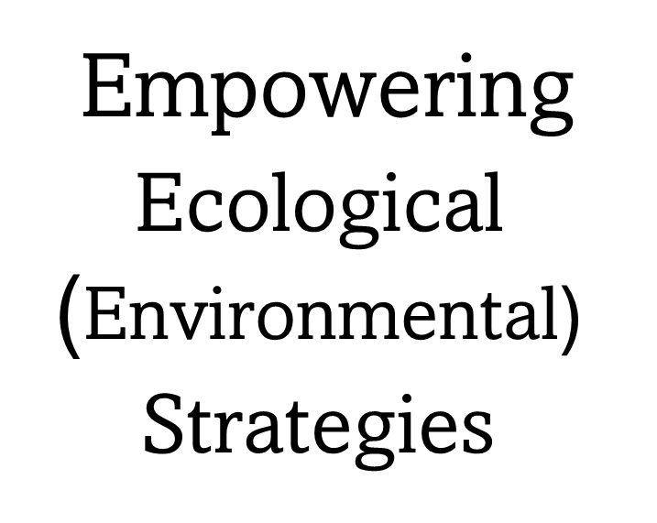

Slide 33
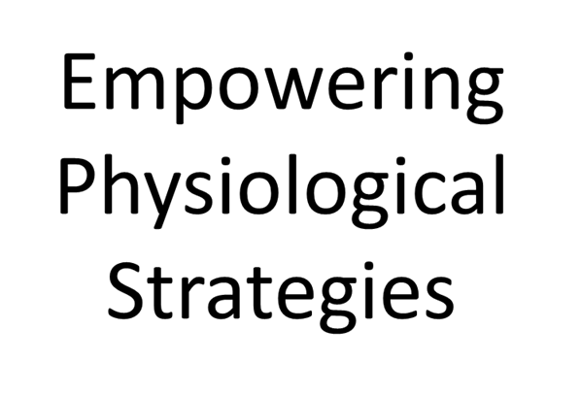
Every two hours think FAST
Wiggle breaks
Kosmic kids.com
Engine plates
Get night light, sound machine, etc.
Google dehydration chart.
Fidgets- Flexible seating
Weighted items
Objects to chew
Be scent aware
Noise cancelling headphones
Notes:
Ecological is setting up the environment for success. Physiological is meeting the needs of the body.

Slide 34
Putting it all together: Be A Detective
Find behavior patterns by tracking;
Who is with the child
What are the sights, smells, textures, tastes and sounds.
When does it occur
Where does the behavior occur?
Think F.A.S.T!

Slide 35
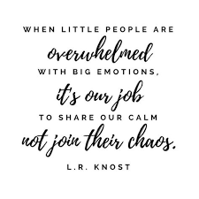
Anchor them in calm and connection

Slide 36
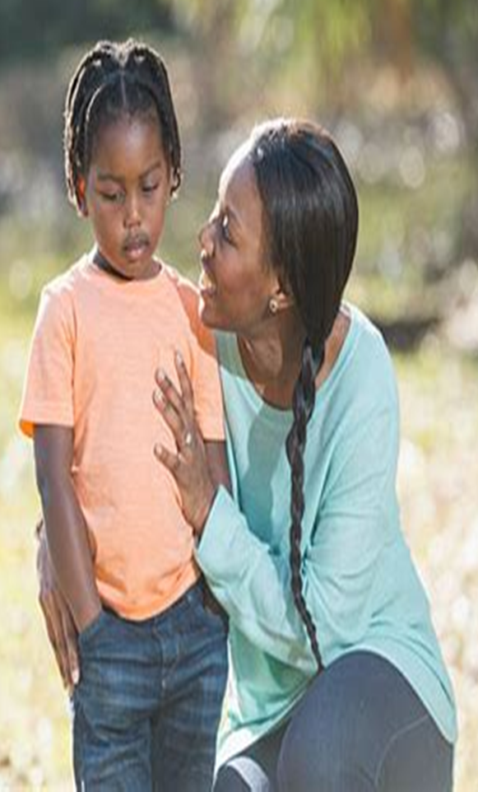
Notes:
When your child is heading for a meltdown, Stay CALM, Think FAST.
The Third Principle is Correcting, and that focuses on proactive and responsive strategies to address behavior. Remember that all these principles work together. Correcting Principles won’t be very effective if there isn’t a regular pattern of applying the Connection Principles (building trust) and the Empowering Principles (build regulation and emotional skills) Think of these three principles working together as a pyramid, with the broadest part of your base being the Connecting Strategies, the second biggest focus on Empowering, and the top of the pyramid being Correcting Principles. That is what you are striving for.

Slide 37
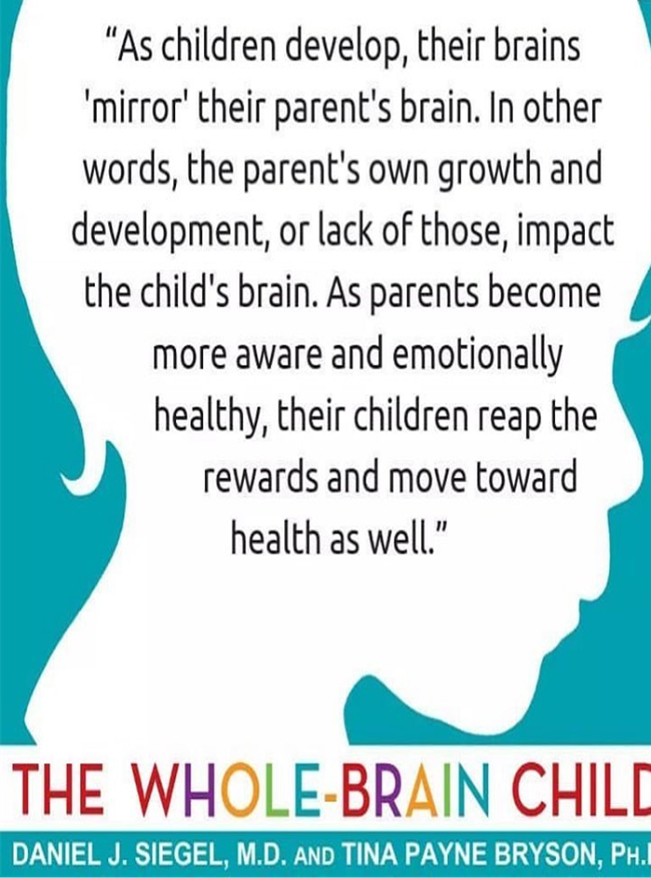
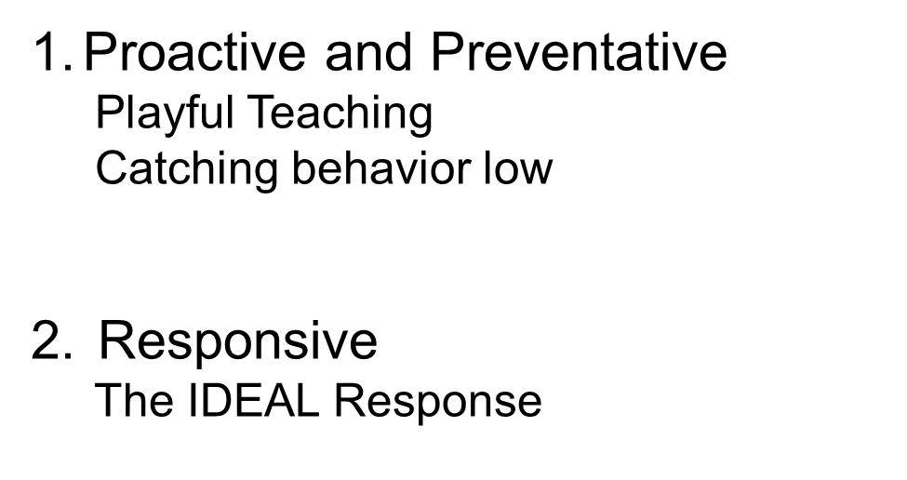
Notes:
When your child is heading for a meltdown, Stay CALM, Think FAST
In Correcting Principles, there are two sets of strategies.
In proactive strategies, we focus on putting the child on the right path before they even have a chance step foot onto the wrong one. By doing this, we are setting a child up for success. One big proactive strategy is to “encourage the positive.” In encouraging the positive, we aim to consistently praise the child for correct behavior (positive) instead of only focusing on what the child does wrong (negative). If a child does something in the right direction, even something as little as asking politely for a snack, it’s important to be intentional in saying, “Thank you for using your good asking words! I love it when you speak so nicely.” Or if a child is being gentle when handling an animal, say, “Thank you so much for being gentle and kind! That’s so sweet of you. High-five!”
The Second strategies include your responsive strategies—those strategies that you will be using in the moment that the behavior occurs. As we talk more about these responsive, in the moment strategies, we will be exploring something called the IDEAL Response

Slide 38
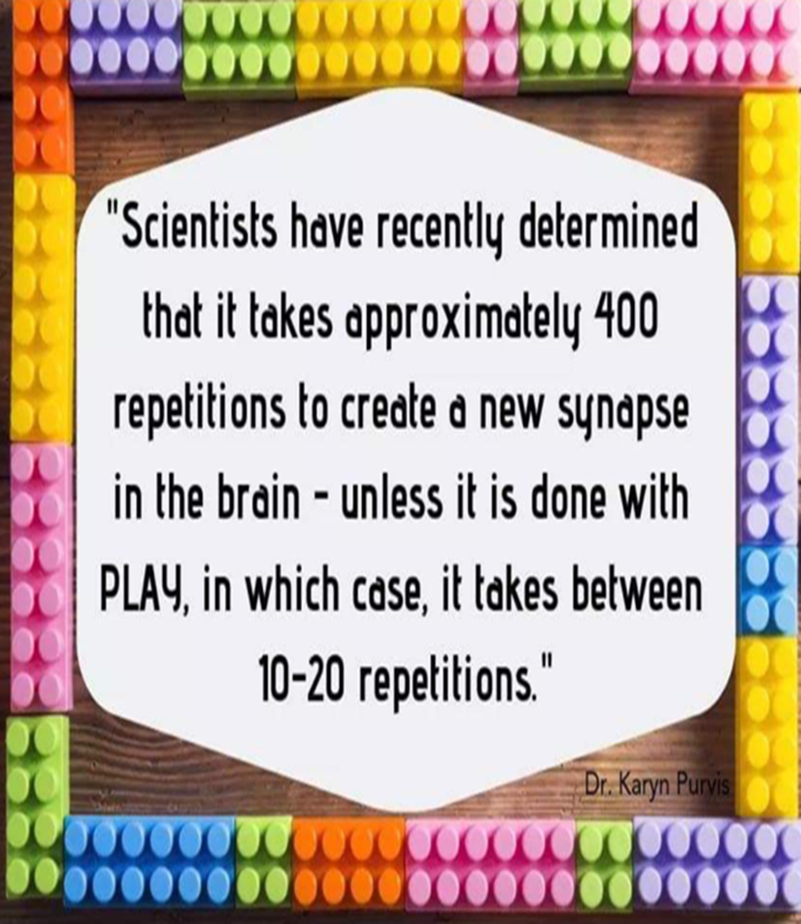
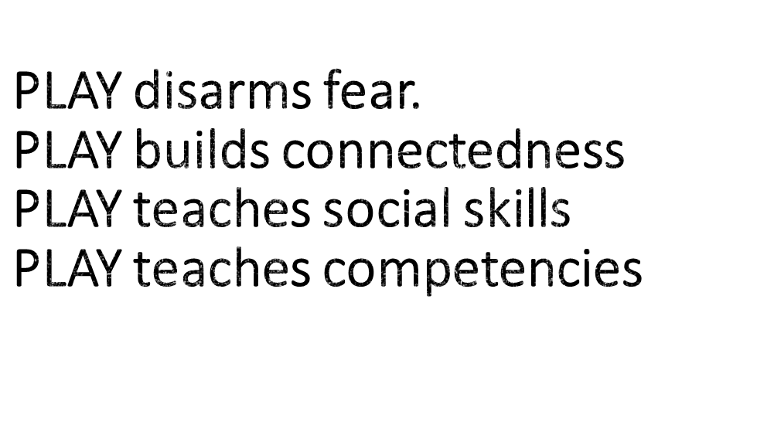
Notes:
When your child is heading for a meltdown, Stay CALM, Think FAST.
The idea of playful teaching in rooted in the science that if we can teach using playful strategies, we will be more successful. Science has determined that it takes approximately 400 repetitions to create a new synapse in the brain unless its done with PLAY in case it takes between 10-20 repetitions.

Slide 39
Notes:
When your child is heading for a meltdown, Stay CALM, Think FAST.
When working on correcting in the moment, think of these strategies as your “TBRI Power Tools.” Instead of moving directly to punishment, think about shifting your focus to helping a child modify their behavior. Your power tools include:

Slide 40
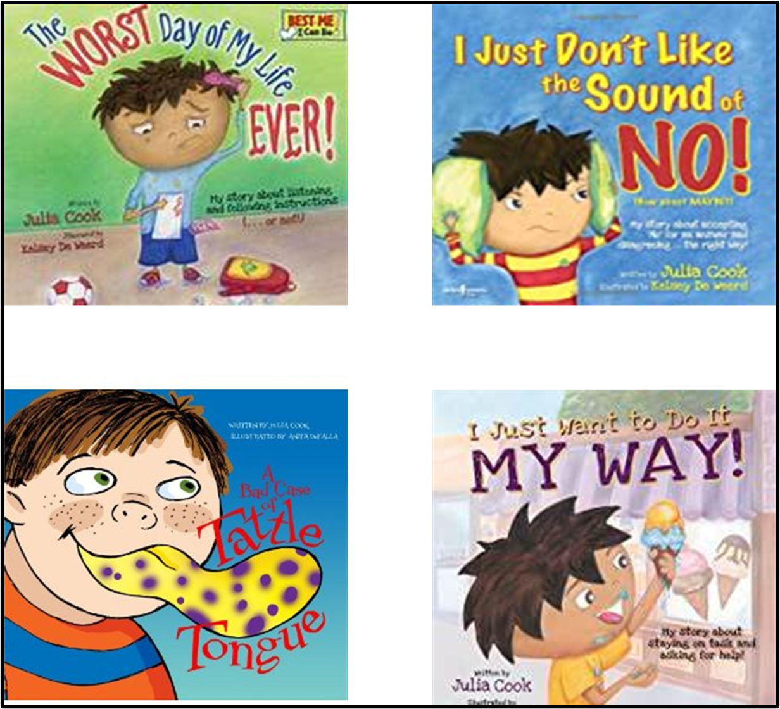
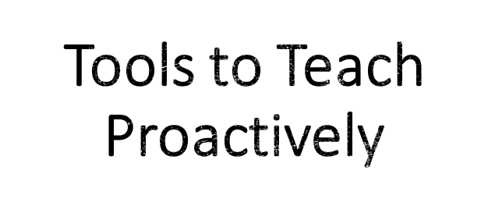
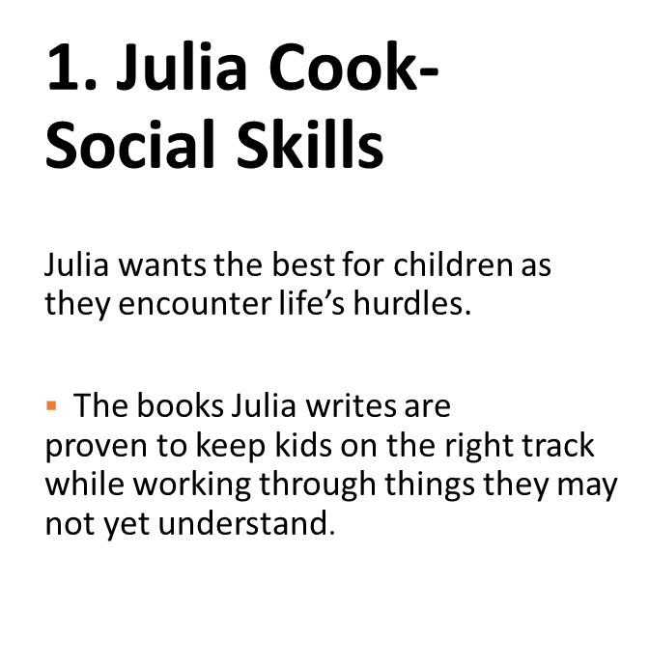
Notes:
When your child is heading for a meltdown, Stay CALM, Think FAST.
You see examples on this slide of children’s books addressing serious topics. Reading a fun story is an example of using a proactive, playful technique to change behavior. These kinds of strategies are more successful in instilling new behaviors than using a punitive approach.
On this slide are some books written by Julia Cook and she writes many of the books you see. Reading books about behavioral habits or issues can be a playful way of introducing other ways of interacting.

Slide 41
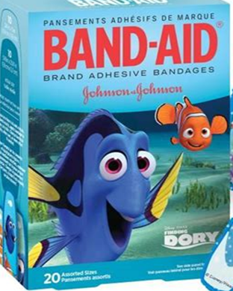
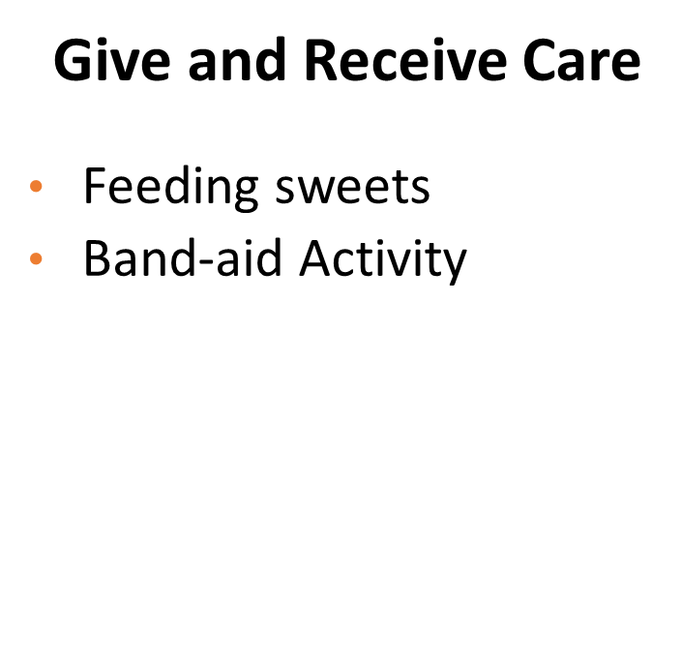
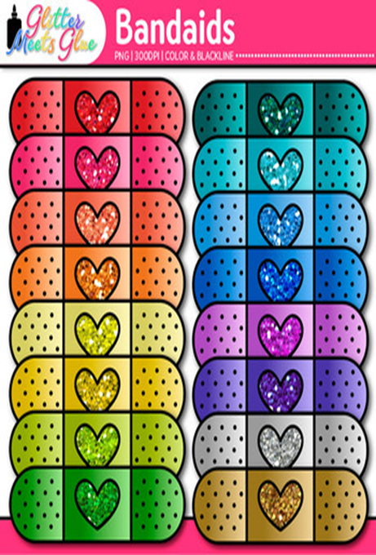
Tools to Teach Proactively
Nurture their little and invisible hurts and they will come to you their big, real ones.
Notes:
When your child is heading for a meltdown, Stay CALM, Think FAST.

Slide 42
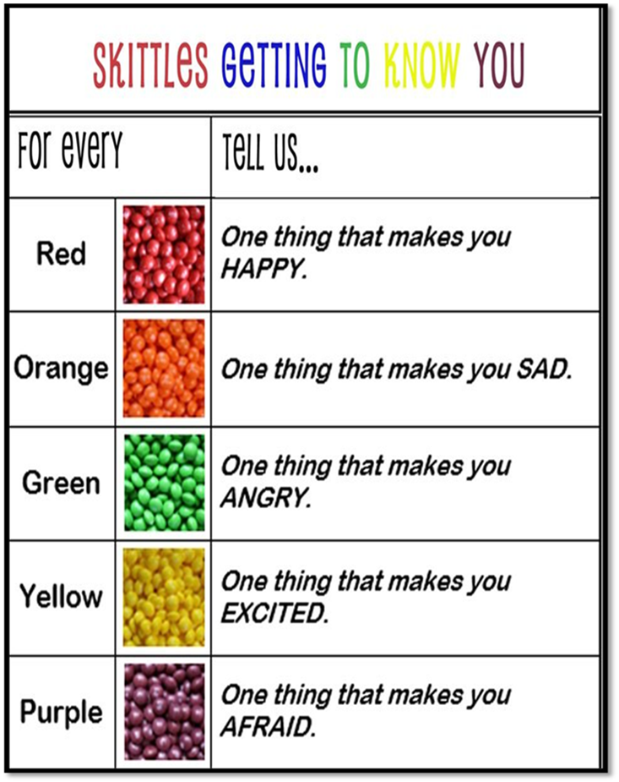
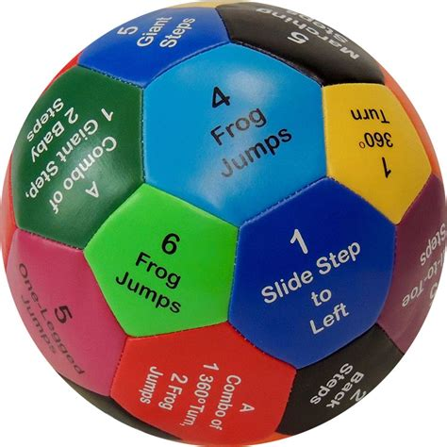
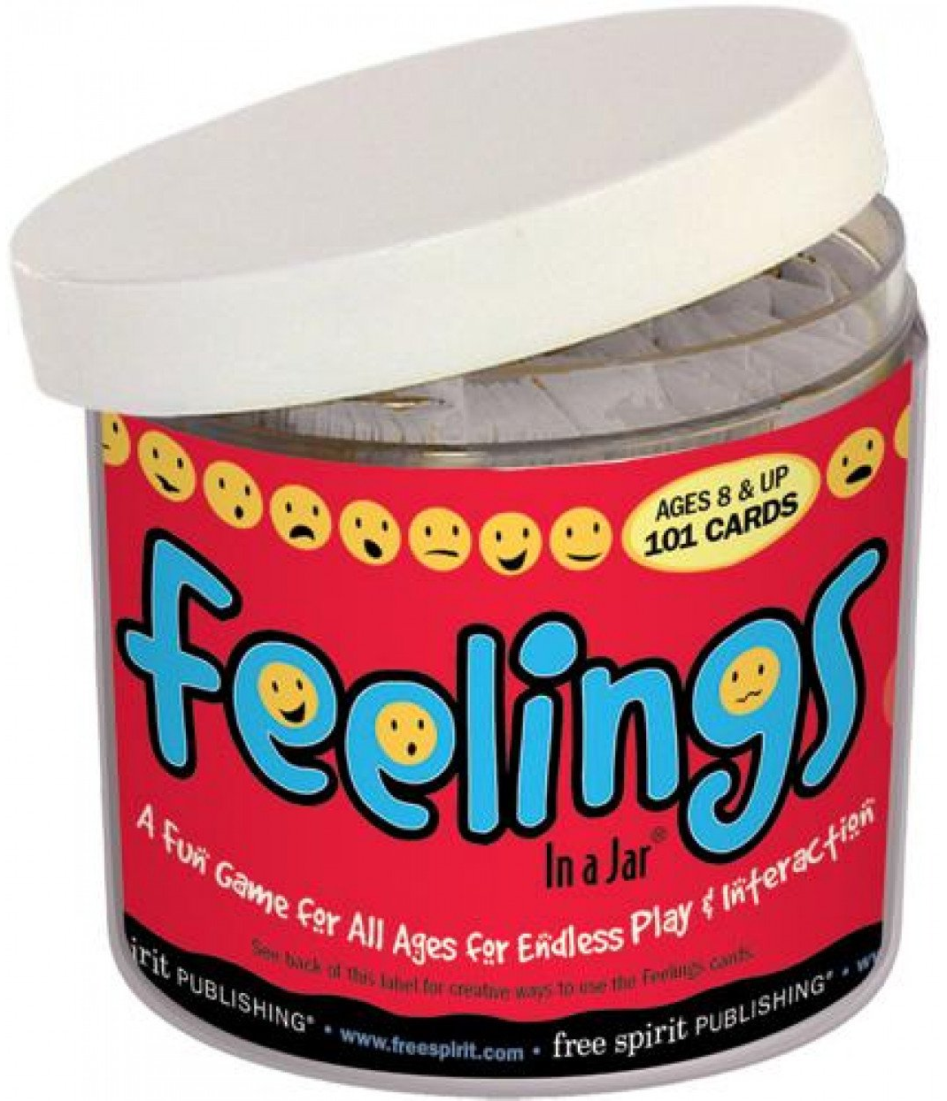
Notes:
. Teach children
Negotion
Social Skills
Words have power
Keeps behavior moving forward.

Slide 43
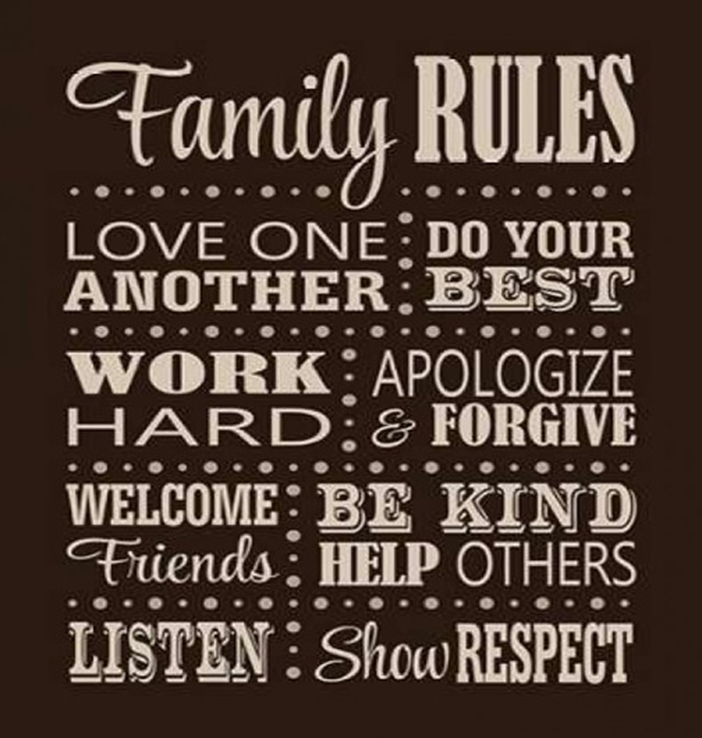
TBRI® LIFE VALUE TERMS
Are you asking or telling?
Use your words
“Whoa Nelly! Try again with respect
Gentle and kind
No hits no hurts
Stick together
Accept “no”
Listen and do
Who the boss?
Ask don’t sneak
Tell me what you need.
With permission and supervision
Respect the no
Read the room
You touch it , you take it.
Notes:
. Activity: Choose three you will start with your family this week.
How will you teach this in a fun way?
Life Value Terms or Life Value Scripts. Such as showing respect, using your words, being gentle and kind, who is the boss, listening and obeying, and accepting the answer no. We will not go into detail on this point, but please reference the Handout titled LIFE VALUE SCRIPTS. They even have free downloadable posters that you can put up in your home.
BACKGROUND: Children who are adopted from foster care are not in need of families because of happy circumstances. These children need a family because their biological family was unable or unwilling to do so. Poverty, abuse and neglect are likely to have affected your child’s early development and may not have had positive social skills modeled for them in their early years. Social skills like respect, listening, and obedience are necessary for navigating relationships with adults and may be a foreign concept to your child. It is not fair to the child to expect he or she inherently understands the complexities of social interactions without such skills being modeled for them. For many children who have been adopted, the social skills necessary to successfully navigate their world can be taught through patience and practice with the help of parents
To help children from “hard places,” we encourage a concept called “Life Value Terms” that are easy for them to understand. These are simple ideas that you point out, model the skill and have the child practice the skill. In TBRI, Dr. Karyn Purvis explains these “scripts” as using a few meaningful words to teach appropriate social skills. These phrases are short and to the point, so that children can understand the terms clearly. Being verbose or lecturing children, especially those with learning difficulties, often does not work in teaching and correcting social behaviors.
Reference: HANDOUT #5-3: LIFE VALUE SCRIPTS
Free downloadable posters: https://child.tcu.edu/wp-content/uploads/2017/07/TBRI-LVT-10-Pack.pdf
We are going to go over a few examples of these scripts and how they can be used. (go over examples before discussing main point).
EXAMPLES: Pick Two Scripts Below or use these examples to illustrate
“Are you asking or telling?” An example of this script would be if a child demanded, give me some french fries. You would respond, whoa, are you asking or telling? Then state, “try again with respect.”
Try again with Respect Teach the child to treat themselves and others with respect. There is no tolerance for disrespect of any kind. Respectful behaviors include respectful voice, respectful facial expressions and attitudes, respecting others’ space, and respecting others’ belongings. If a child is disrespectful, redirect with the short statement, “Try that again with respect.” When the child is respectful, reinforce with, “That was great showing respect!”
With Respect Teach the child to treat themselves and others with respect. There is no tolerance for disrespect of any kind. Respectful behaviors include respectful voice, respectful facial expressions and attitudes, respecting others’ space, and respecting others’ belongings. If a child is disrespectful, redirect with the short statement, “Try that again with respect.” When the child is respectful, reinforce with, “That was great showing respect!”
“Listen and mind” The parent or teacher is the authority with the child. When a child is given an instruction, it can be helpful to remind them, especially if
they hesitate in following the direction, to “listen and obey.” Always follow with, “Good listening and obeying.” We implement “practice drills” in the form of games that require immediate compliance, such as “Simon Says” so that the child can playfully practice the skill. By using the game “Simon Says,” we will ask the child to mimic our words, voice (tone, loudness) body, and facial expression “matching.”
“Use Your Words” At-risk children often express their feelings with tantrums, running away, or aggression. Although it is important to understand these
behaviors in terms of the underlying feelings, it is important to continually prompt the child to “use your words” to express needs and feelings. It is also helpful to model this script yourself. You might tell your child, “Right now I am feeling sad. What are you feeling?” Be sure to praise them with, “That’s great using your words!” when they talk.
************************************************************
Main Point: Initially these phrases may be meaningless to a child, but it is up to parents to give those phrases meaning. A parent should model and teach what these scripts mean and then use them to prompt appropriate responses in a child that should then be noted and praised.
.

Slide 44
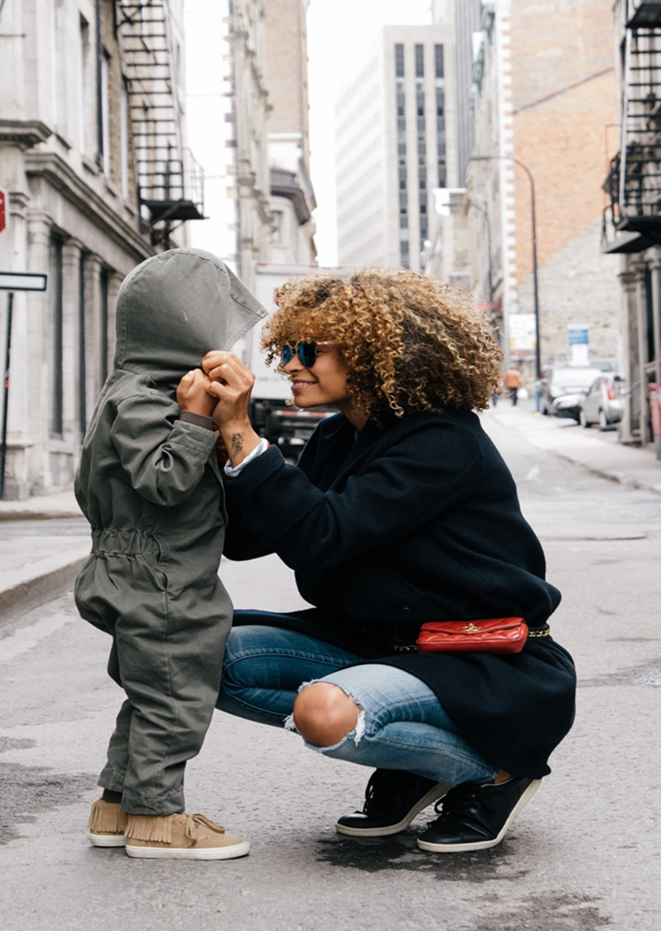
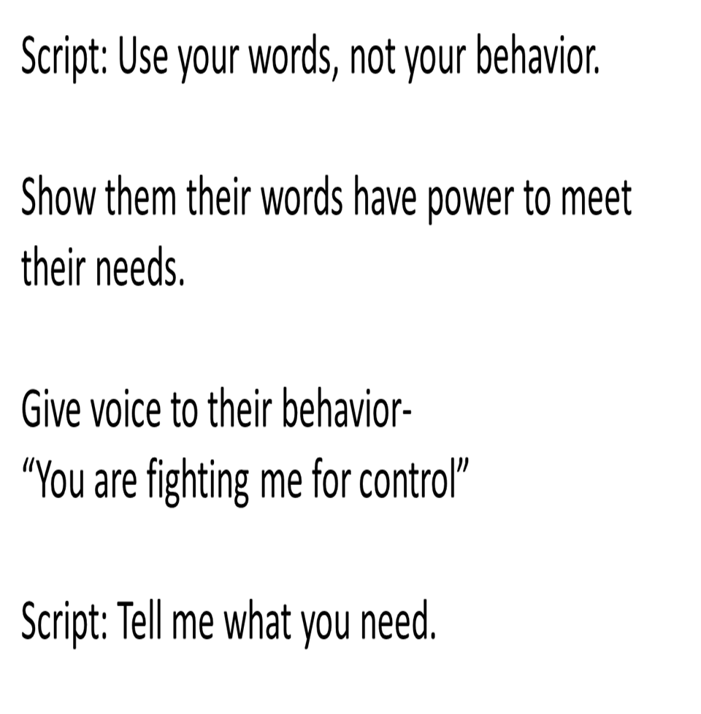
Give Voice
Notes:
. Teach children
Negotion
Social Skills
Words have power
Keeps behavior moving forward.
Giving choices of what the child can do next. The key to using this strategy is that you must be okay with either choice. There is no “right” or wrong” choice. For example: Would you like to do your homework or fail? Is not a good choice because you would not be okay with the choice to fail. Would you like to do homework when you first get home from school or after dinner? would be a choice you could give and live with the response.

Slide 45
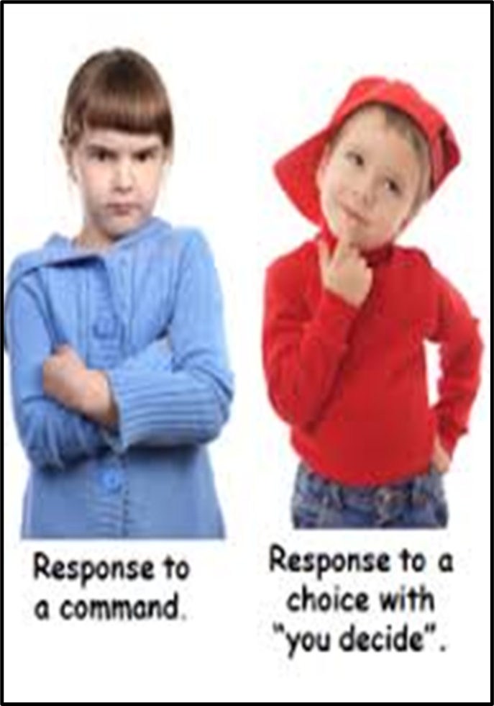
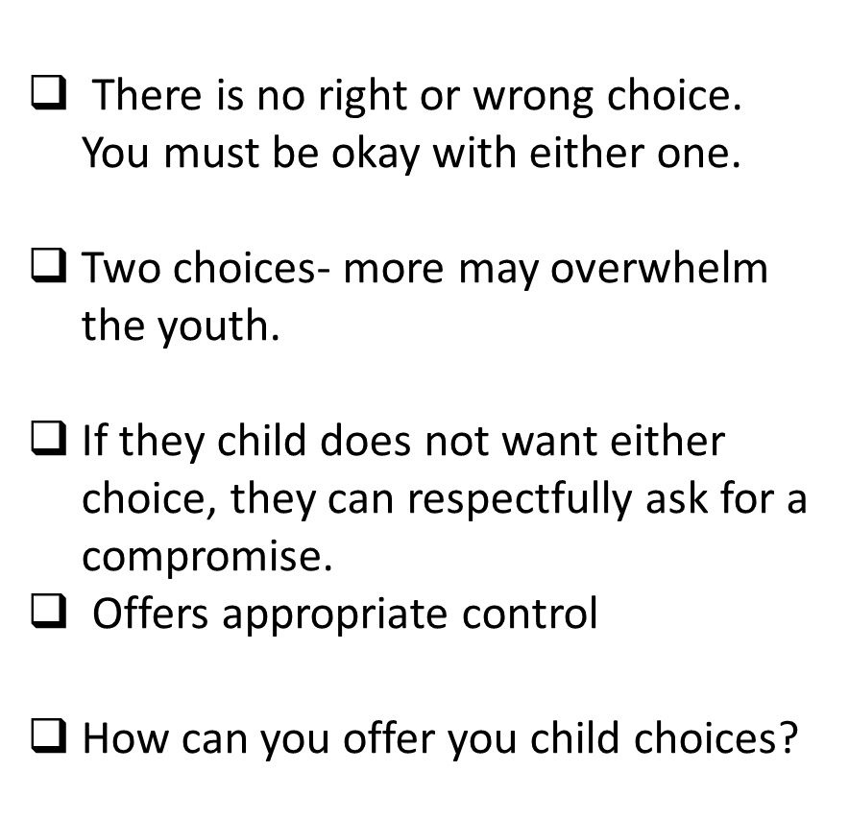
CHOICES
Notes:
. Teach children
Negotion
Social Skills
Words have power
Keeps behavior moving forward.

Slide 46
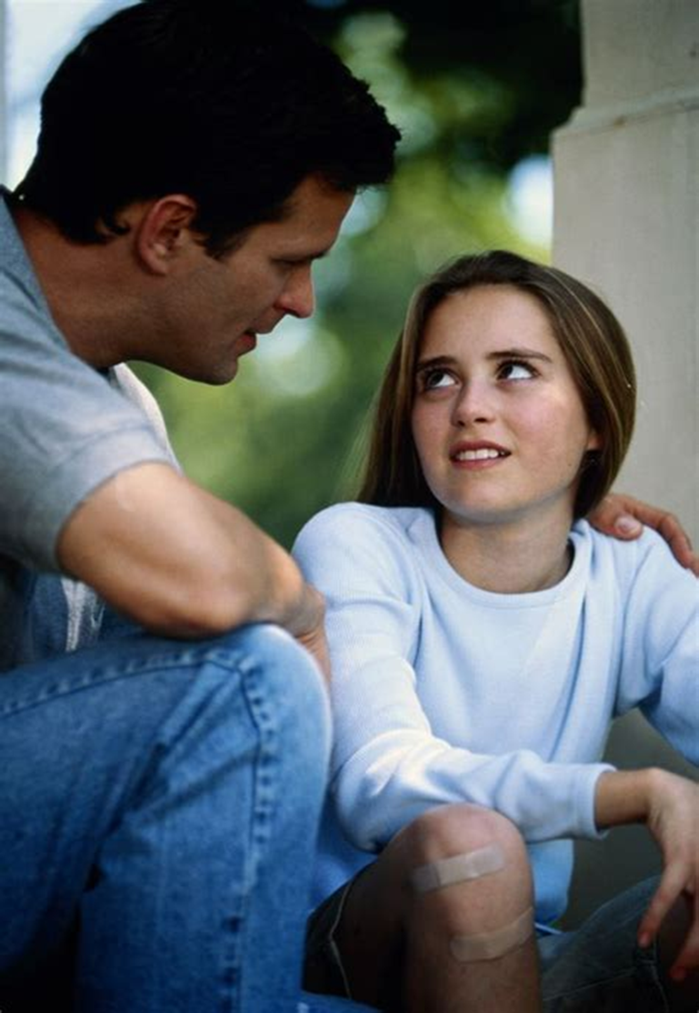
A compromise is a way to:
Share power
Give voice to the child
Allow the youth to respectfully ask for what they want and need
Build trust and connection
Collaboratively problem solve
Compromises
Notes:
Compromise The compromise is another strategy that might be new to participants. When a child can ask for a compromise, you are not giving them all the control and the power. You give them an opportunity to ask to share some power with them and allow their voice to be heard and their needs to be met. It is a way to avoid power struggles and tantrums while still maintaining parental authority. Here is an example of how a compromise might look:
Example of Compromise: Excerpt by Kayla North Example
Me: Son, please go get your room cleaned up. Son: (who is playing a video game) Ugh!! Can’t I just finish this level first? Me: Whoa! I don’t like that tone. Are you asking for a compromise? Son: Yes. Me: I’m listening. Son: May I have a compromise? Me: What’s your compromise? Son: May I finish this level on my game and then go do it? Me: Sure! That’s a good job asking for a compromise!
By using compromises our kids have learned that they have a voice. They know that I can’t always give them or agree to a compromise, but they also know that I will as often as I can. And the funny thing is that they now can accept ‘no’ much better than in the past. Remember – compromising is NOT about allowing our kids to argue or debate with us, nor is it about losing our control or giving them all the control. It is about sharing power – our power. Compromises give our kids a voice and allow them to RESPECTFULLY ask for what they want and need. And compromises give us as parents the opportunity to teach our kids an important way of relating that builds trust and connection.
. Teach children
Negotion
Social Skills
Words have power
Keeps behavior moving forward.

Slide 47
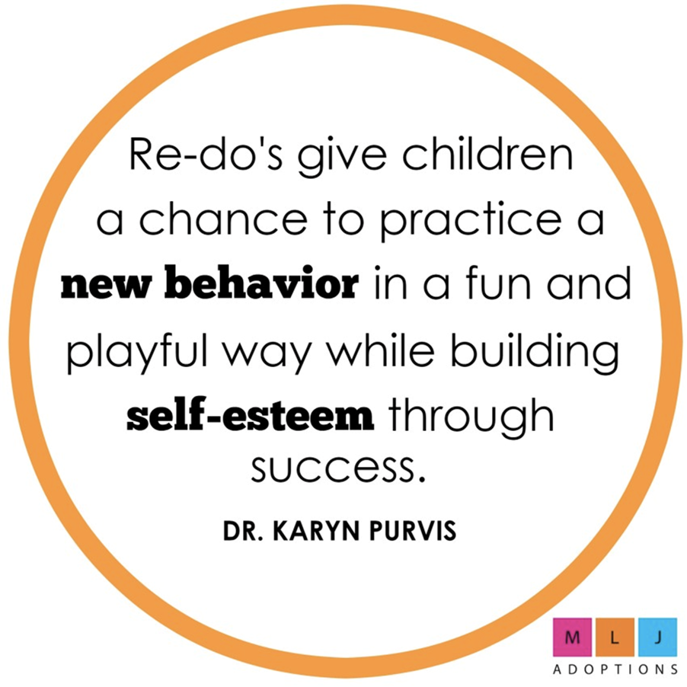
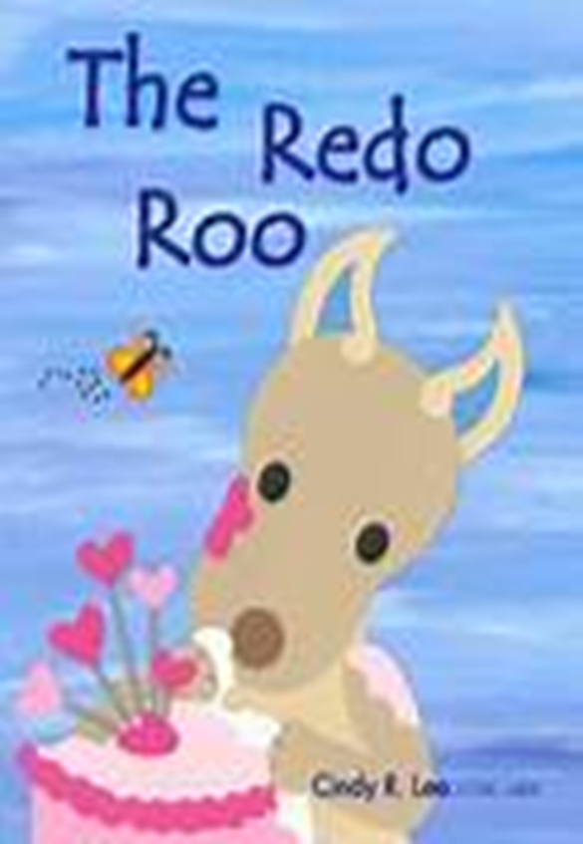
Or it won’t end well for either of you!
Notes:
Re-dos This might be a strategy that is new to you. A re-do gives a child a chance to practice doing the right thing the right way. This is not a punishment but a way to create body memory and brain connections for the correct behavior. If the child can try again, do it right, and get praised for doing the right thing, it strengthens the brain connections for appropriate behavior.
. Teach children
Negotion
Social Skills
Words have power
Keeps behavior moving forward.

Slide 48
Correcting: Proactive Strategies
What is one behavior your child does that drive you crazy?
What do you want them to do instead?
How will you teach them the behavior?
How will your practice it?

Slide 49
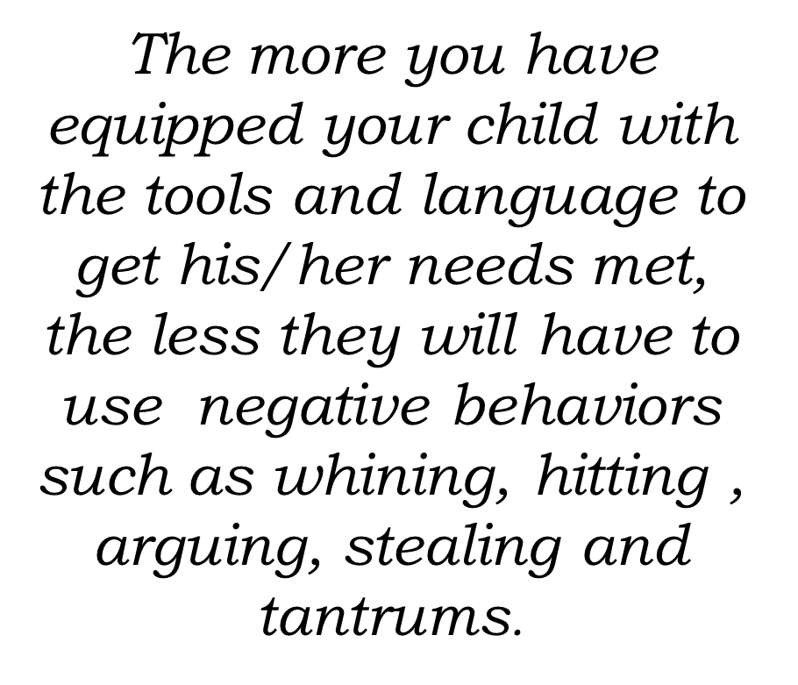
Notes:
There are 3 goals to effectively correct a behavior. These goals are:
Maintain connection with the child throughout the process.
Children end the episode feeling content (not discouraged or shamed)
Episode ends with behavioral change.
*3 C’s*
Connection
Content
Change
. Teach children
Negotion
Social Skills
Words have power
Keeps behavior moving forward.

Slide 50
Notes:
. Teach children
Negotion
Social Skills
Words have power
Keeps behavior moving forward.

Slide 51
“An Adoptive Family is a remarkable environment for healing form emotional and physical traumas and can reverse developmental deficits.”

Slide 52
Notes:
The quote sounds basic and easy until you add the picture of the not so lovable child into the mix. It is hard in the midst of the child’s worst behaviors that they are precious.
Karyn: Precious beneath the poo story.
Reference: HANDOUT #5-4: LIST OF TBRI Resources

Slide 53
COURSE REVIEW
Session 1: Beginning Connections
Exploring Motivations and Expectations in Adoption
Trust, Attachment and Development
Session 2: At the Heart of Adoption
Grief and Loss
Session 3: Talking About Adoption throughout Development
Session 4: Identity and Adoption
Session 5: Trauma Informed Parenting with TBRI
Notes:
FINAL REVIEW OF CLASS
We have come to the end of our course. Let’s review what we have done in this class.
In our first session: Expectations for Adoption, Developmental Stages and how they are impacted by trauma and adoption and different parenting Styles.
In our second session: we looked at grief and loss through the eyes of the 3-5-7 model, and looked at ambiguous loss.
The third session explored different facets of identity including developmental tasks in adolescence, racial and cultural identity, developing an adoption narrative, and developing a sense of mastery and control.
And in this final session, we learned about the three principles of TBRI—Connecting, Empowering and Correcting and had a bit of practice in applying it

Slide 54
Course Evaluation Poll
Notes:
POLL- Course Evaluation
How would you rate the overall training? (Excellent, Good, Average, Fair, Poor)
How knowledgeable were the presenters? (Excellent, Good, Average, Fair, Poor)
How well did the presenters respond to participants? (Excellent, Good, Average, Fair, Poor)
How well do you feel this training added to your skills or knowledge? (Excellent, Good, Average, Fair, Poor)
Please select the areas of this training that you liked, select all that apply (New information to me, PowerPoint Material, Handouts, Lecture, Relevant to my situation, Video, Open Discussion)

Slide 55
The End of Class… But The
Beginning of Your Journey!
You are not alone… Your ACRF Adoption Team
Brenda Ursel- Adoption Support (Anchorage)
Timothy Ledna- Adoption Support (Fairbanks/Northern AK)
Erin Monarch – Adoption Support (Southcentral, Southeastern, Western)
Karissa Hughes- Adoption Resources - Fairbanks
Alaska Center for Resource Families www.acrf.org
1-800-478-7307
Notes:
CLOSING EXERCISE: Optional At this point in the class, you may wish to use some sort of closing exercise, such as going around the room and asking each person to say one thing that they are taking away from this class to consider, implement, or think more about
CONCLUSION: Please remember ACRF as a source of support as you move forward in your parenting. This is the end of this class, but the beginning of your journey and we will continue to be available to help your family be successful.
Evaluation
Certificates of Attendance

